Slide 1


Exprime tus proyectos SPFX
Ruben Toribio | Luis Mañez
6 of November 2021
Notes:
Template may be modified but please keep the title and the sponsor slide.
Twitter hashtag: #CollabdaysBCN for all sessions

Slide 2

Ruben Toribio
SharePoint & M365 Architect and Full Stack Developer Hiberus
@Rtoribiog
6 of November 2021

Slide 3

Luis Mañez
Chief Architect
ClearPeople
@luismanez
6 of November 2021

Slide 4









Gold
Online
Organized by
Notes:
Use this as the first slide in your slide deck

Slide 5
Agenda
Welcome
Spfx WSL2
Managing multiple spfx solutions
Spfx Fast serve
Go to Production !!
Testing also is important
Modernize your spfx projects

Slide 6
SPFx
WSL2

Slide 7
01.
Install Windows Terminal
02.
Install WSL2
Install it from Windows Store
https://docs.microsoft.com/en-us/windows/wsl/install
03.
Beautiful prompt
04.
Install Node Version Manager
https://www.hanselman.com/blog/how-to-make-a-pretty-prompt-in-windows-terminal-with-powerline-nerd-fonts-cascadia-code-wsl-and-ohmyposh
https://github.com/nvm-sh/nvm
05.
Install NodeJS using NVM
06.
Setup SPFx
nvm install 14.18.1
nvm use 14.18.1
sudo apt-get install build-essential
npm install -g yo gulp
npm install -g @microsoft/generator-sharepoint@next
07.
SPFx certificate
08.
Git Setup
New SPFx Project
Npm install
Gulp trust-dev-cert
Import manually the certificate found: $home/.rushstack
git config --global user.name "John Doe"
git config --global user.email {your_github_email}
git config --global core.filemode false
git config --global core.autocrlf true
https://www.m365-dev.com/2020/05/29/setup-wsl2-for-spfx-development/

Slide 8
Gotchas installing WSL2
No network connection
echo "[network]" | sudo tee /etc/wsl.conf
echo "generateResolvConf = false" | sudo tee -a /etc/wsl.conf
sudo rm -Rf /etc/resolv.conf
echo "nameserver 8.8.8.8" | sudo tee /etc/resolv.conf
sudo chattr +i /etc/resolv.conf
Sharing SSH Keys between Windows and Linux
https://devblogs.microsoft.com/commandline/sharing-ssh-keys-between-windows-and-wsl-2/
Yeoman too slow
Ensure you are using latest versión
Yeoman cannot find generators
Run: yo doctor
You might need to re install YO generators after upgrading

Slide 9



Empty SPFx Project | Windows | Ubuntu (WSL2)
Npm install | 1 min 57 secs | 1 min 34 secs
Gulp bundle --ship | 15 secs | 11 secs
Gulp package-solution --ship | 4.38 secs | 2.4 secs
Delete node_modules folder |  | Na y menos

Slide 10

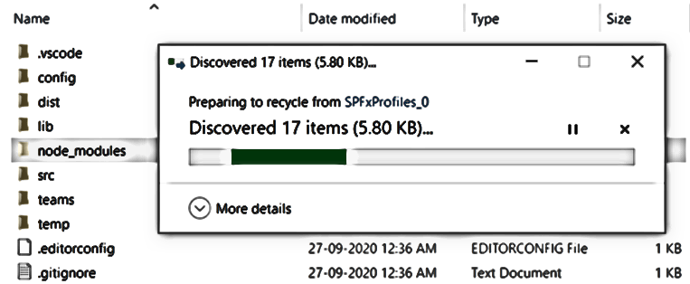

Slide 11

WSL2 demo

Slide 12

Managing multiple SPFx solutions

Slide 13
Contoso intranet SPFx solution
contoso-intranet
webparts
my-groups
cool-weather
my-expenses
stories
todays-lunch
extensions
Custom header / footer
translate-page
libraries
contoso-ui-components
graph-groups-services

Slide 14

Lerna
$ npm install –-global lerna
$ lerna init
$ lerna bootstrap
$ lerna run build
$ lerna run –parallel serve
https://spblog.net/post/2019/06/24/using-lerna-to-manage-spfx-projects-with-library-components

Slide 15
Lerna demo

Slide 16

SPFX Fast Serve

Slide 17
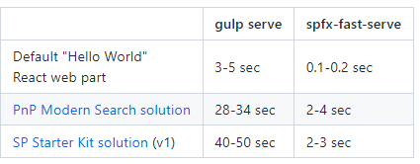
SPFX Fast Serve
Time is what happens while you wait to compile the changes of your project
Apply changes in your project: easy !!!
npm install spfx-fast-serve -g
Open a command line in a folder with your SharePoint Framework solution you want to speed up.
Run spfx-fast-serve and follow instructions. In most cases you shouldn't do anything specific and the cli "just works".
Run npm install
Run npm run serve and enjoy the incredible speed of serve command!

Slide 18
Fast serve demo

Slide 19
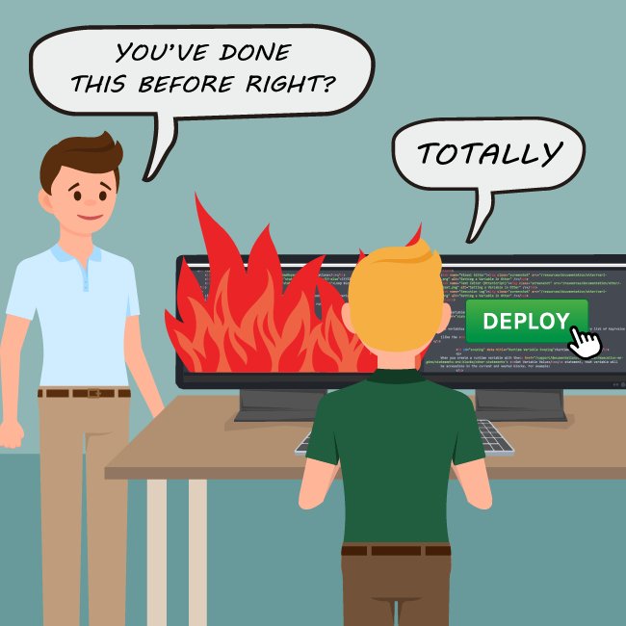
Go to Production

Slide 20
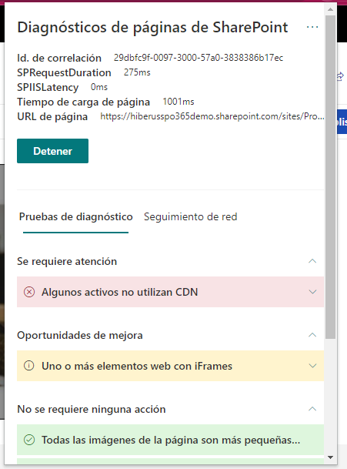
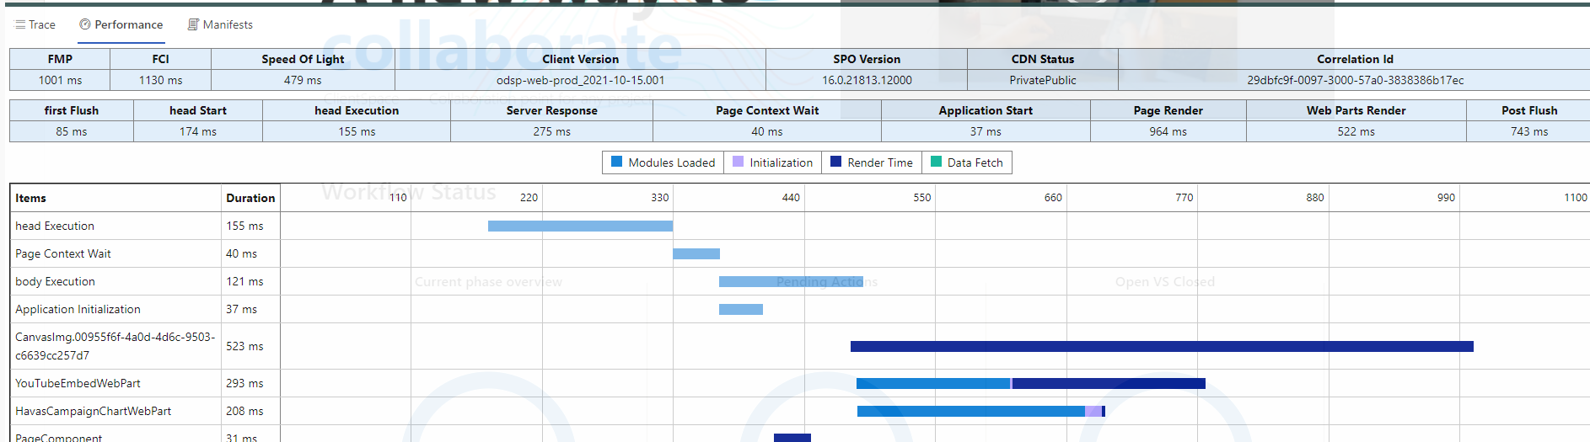
Go to Production
Things to do
SharePoint site performance plugin
Enable CDN
Iframe
loading time
Check image size
Developer Dashboard
Bundle size improvements

Slide 21
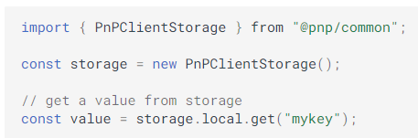
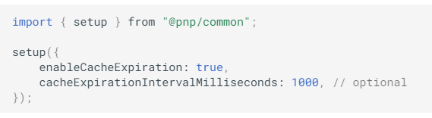
Go to Production
Things to do
Use cache with timeout / expiration
Session storage - persists until window closed
Local storage – persists until explicitly cached
Try to minimize the HTTP calls or use batching
Update dependencies to latest version
Spfx
pnpjs

Slide 22
Performance improvements

Slide 23

Bundle size improvements

Slide 24
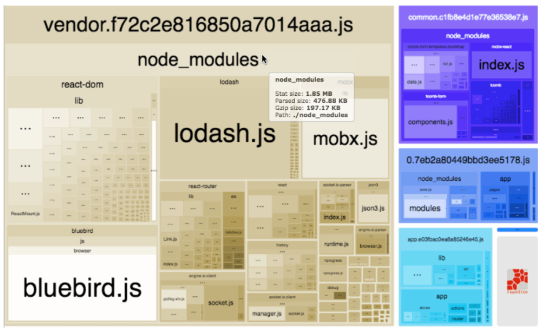
Bundle size
put your solution on a diet
Webpack Bundle Analyzer
npm install --save-dev webpack-bundle-analyzer
Modify gulpfile.js and webpack.js

Slide 25
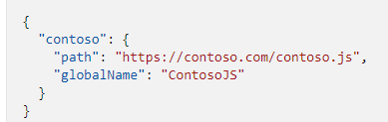
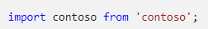
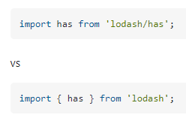

Bundle size
put your solution on a diet
Reference only need it components / functions
Check if tree shaking enabled
Use internal references before external , like lodash, moment
Externalize 3 party references

Slide 26
Webpack bundle analyzer

Slide 27

Testing is also important

Slide 28

How to enable tests
Not included by default
Easy way :
Install @voitanos/jest-preset-spfx-react16
Install @voitanos/jest-preset-spfx-react15
More important quality than quantity
Enzyme
Sinon

Slide 29
Testing

Slide 30

All in one
PnP/generator-SPFx
Multiple libraries like react , vue , angular , jquery
Testing
Webpack analyser
Last spfx version 1.11.0
PNPJS
PNP Spfx Controls
Spfx fast serve coming soon (not by default)

Slide 31
Modernize your spfx projects
No more IE11 support!!
https://www.voitanos.io/blog/optimize-spfx-bundles-ditch-ie11-support/
ESLint over TSLint
https://www.voitanos.io/blog/spfx-replace-tslint-with-eslint-preset/

Slide 32
No more IE11 demo

Slide 33
https://github.com/luismanez/collabdays-bcn-2021

Slide 34
Resources
https://www.m365-dev.com/2020/05/29/setup-wsl2-for-spfx-development/
https://devblogs.microsoft.com/commandline/sharing-ssh-keys-between-windows-and-wsl-2/
Using Lerna to manage SPFx projects with library components (spblog.net)
https://github.com/webpack-contrib/webpack-bundle-analyzer
https://github.com/s-KaiNet/spfx-fast-serve
https://github.com/SharePoint/sp-dev-docs/blob/master/docs/spfx/toolchain/optimize-builds-for-production.md
https://pnp.github.io/generator-spfx/
https://github.com/pnp/sp-dev-fx-webparts/tree/main/samples/react-jest-testing

Slide 35
Thank you!
Questions?
#CollabdaysBCN

